Slide 1


Rethinking academic integrity:
Transparency and evidence in the AI era
How Mentafy closes the gap between AI detection, fairness and students’ own work
FAIRNESS
CRITICAL THINKING
WRITING SUPPORT

Slide 2

Challenges with AI
Mentafy’s solution
Appendix: Software overview
1
  AGENDA
2
3
2

Slide 3
Challenges with AI
1
3

Slide 4

Challenges 1/4
Theses on the future of academic integrity
YES
NO
1
Academic writing and research should still be practiced through theses.
Alternative assessment formats are very valuable, of course, but they do not replace academic writing.
2
Students who let AI do too much of their writing risk learning too little.
3
Documenting how a text was written can show how much of the work is the
student’s own.
4
Nobody reviews every record. An analysis has to show whether a history is unremarkable or deserves a closer look.
4x yes? Then you are in exactly the right place. 3x yes? Then let’s convince you!
4
Notes:
Before we start: four statements. Answer each one for yourself with yes or no. First: academic writing should still be practiced through theses. Alternative assessment formats are valuable and worth pursuing, but they do not replace academic writing. Second: students who let AI do too much of their writing risk learning too little. Third: documenting how a text was written can show how much of the work is the student’s own. Fourth: nobody reviews every record in full. You need an analysis that shows whether a history is unremarkable or deserves a closer look. To be frank: if you say no to any of these, the rest of this webinar is probably not very relevant to you. If you say yes four times, you are in exactly the right place.

Slide 5




Challenges 2/4
Generative AI is changing education
and fueling ghostwriting and plagiarism
35%
AI cheaters
35% of students surveyed have already had generative AI write term papers or theses for them
Bitkom study Digital Universities, 03.2025
94%
undetected
In one study, 94% of AI-generated submissions went undetected – and on average scored half a grade higher
A real-world test of artificial intelligence infiltration of a university examinations system: A “Turing Test” case study, Reading University 06.2024
→ This is not new! And across studies (e.g. HEPI) the numbers,
if changing, clearly increase since 2024.
5
Notes:
Did the student write the text herself?
Does your old plagiarism checker flag suspicions you can’t trace?
Do cheaters get away with it, and maybe even get better grades?
-> AI ghostwriting is already widespread and growing
-> Traditional detection at submission does not work
Detection rates keep falling as generated texts become more human-like
False positives keep increasing
No evidence of possible misconduct

Slide 6
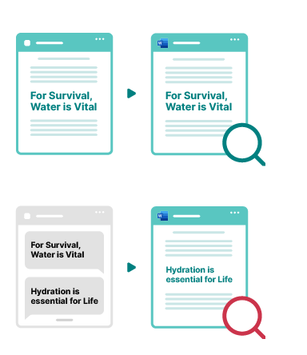
Challenges 3/4
Generative AI pushes existing tools to their limits:
Cheaters evade plagiarism checks by paraphrasing with AI
Cheaters defeat AI detectors and watermarks with targeted prompts and ‘humanizers’ – using the same technique
Web source
Final text
ChatGPT
Final text
When a text is AI-generated with a targeted prompt, the rate at which it is correctly classified as AI drops to 26%
Scarfe et al.: A real-world test of artificial intelligence infiltration of a university examinations system: A “Turing Test” case study. PLOS ONE 2024
STANDARD
Plagiarism
check
works
STANDARD
AI
detector
works
Generative AI
New text
‘Humanizer’
New text
SMART
Plagiarism
check
fails
SMART
AI
detector
fails
6

Slide 7
Challenges 4/4
We’ve seen this movie before
THEN: PLAGIARISM
1998
2009
2011
2018
Google launches
PlagScan launches
The plagiarism scandal
Checks become standard
Other people’s texts are seconds away. Copying becomes trivial.
The technology is there, affordable and working. Adoption: low.
A minister resigns, then a series of cases follows. Public pressure changes the situation.
Seven years after the scandal, the solution is in standard use.
TODAY: AI
2022
2023
2026
ChatGPT
Mentafy Writing Process Analysis
TEQSA
In 2011 it took a scandal to prompt action. This time the trigger is already on the table, as a draft law.
The finished text loses its value as evidence: one pass through a paraphrasing tool takes an 86% match down to zero.
Same founding team, same situation as in 2009: proven technology, adoption just beginning.
Australia’s regulator TEQSA names process traces as evidence of learning. Universities are in a similar position to 2011.
7
Notes:
The analogy is the core argument: in 2009 the technology was ready, but decisions were only made in 2011 after the headlines, and then it took seven years. This time the trigger is already here as a draft law, and the tool is built.

Slide 8
Mentafy’s solution
2
8

Slide 9
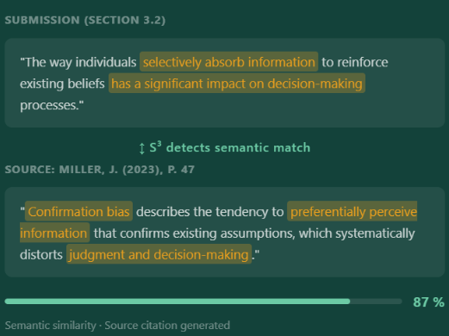
Existing solution improved
Plagiarism checking that detects paraphrases and translations
An innovative addition to the traditional check: Our S³ Semantic Source Search compares meaning instead of word strings and finds the source even when the text has been reworded or translated.
Traditional plagiarism check
Mentafy S³
Finds only verbatim matches
Detects semantically identical passages
Fails on reworded texts
Analyzes meaning and line of argument
Report without sources for paraphrases
Direct comparison: submission vs. source
A single score as the basis for judgment
Several independent indicators and evidence
9
Notes:
The innovative addition built right into the traditional plagiarism check: S³ reads meaning instead of word strings, so it also finds paraphrased and translated plagiarism. Important: it needs no process data and also works on the finished PDF.

Slide 10
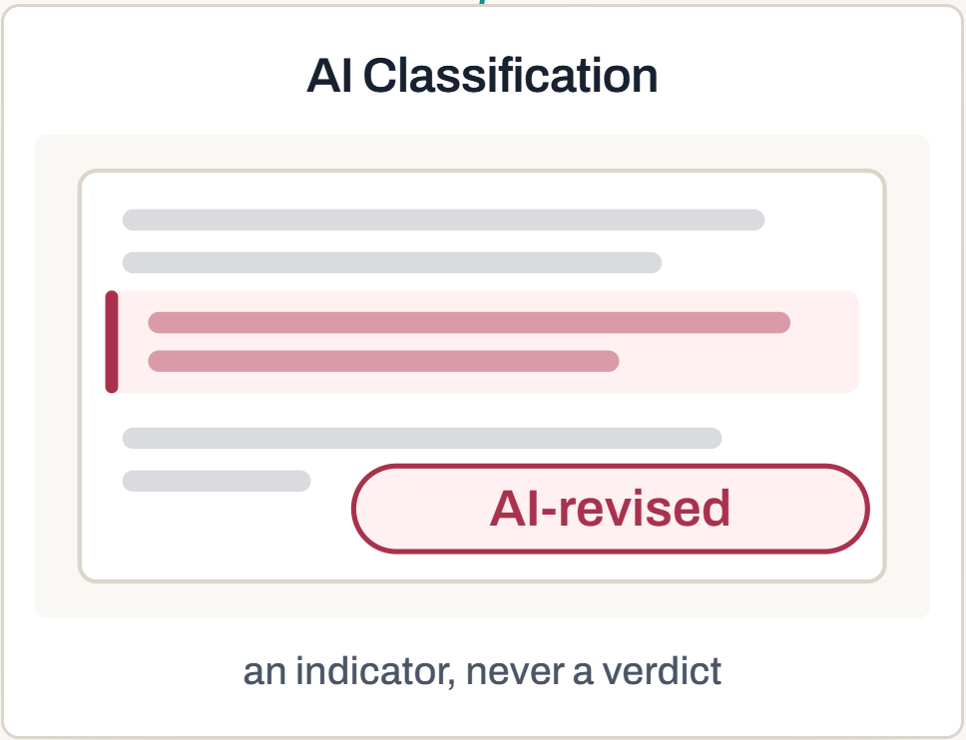
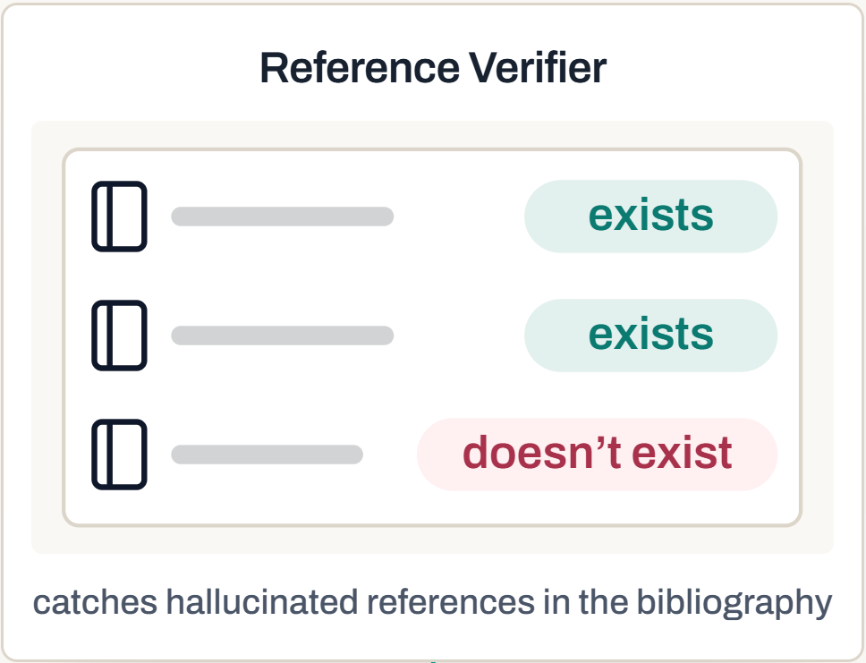
Modules added
AI classification and Reference Verifier
10

Slide 11
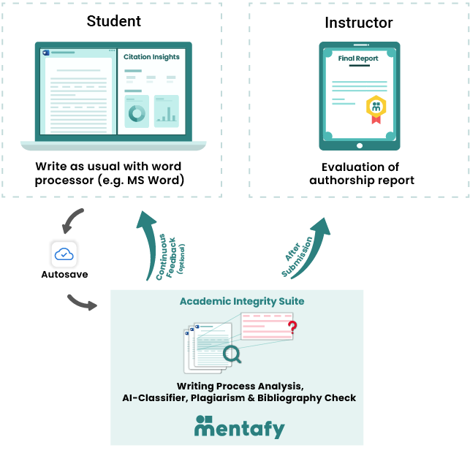
New key technology
Our Writing Process Analysis
Reliably distinguishes copy-and-paste and retyping
from text students came up with themselves
Can also give authors real-time feedback
on working correctly (citing sources)
„The writing process itself is as important (if not more important) than the end product, because it is during the writing stage that the student will learn the most.“
Clare Johnson, Understanding academic integrity and plagiarism in the digital age: Can digital forensics techniques help prevent and detect academic misconduct? (2023), PQDT-Global
11
Notes:
Note: “minimally invasive”, no “transparent students” under surveillance!
Analysis of the auto-save version history (no keylogging)
deleted text is not disclosed
Data control (stored with the student)

Slide 12
The solution at a glance
Solutions for today and tomorrow from a single provider
Dimension
Mentafy Check
(ready today)
Mentafy Trail
(amend assessment policy per TEQSA)
Approach
Checks the finished document. A drop-in replacement for your current checker.
Documents how the work was written: the evidence regulation is moving toward.
Evidence
Finds plagiarism and citation errors; otherwise relies only on AI probabilities
Delivers tamper-proof evidence of students’ own work: traditional check + semantics (S³) and process
Data and documentation frequency
The finished document is checked. Everything works just like your process with plagiarism software.
You decide: automatically about once a minute, or manually. Even one version per week over a semester shows how a piece of work grew.
Analyses
Plagiarism matching, S³ Semantic Source Search for paraphrases and translations, Reference Verifier, and AI classification optimized for German texts, among others.
Everything in Mentafy Check, plus Research Recorder and Writing Process Analysis. Students can get real-time feedback on their citations.
A combination of semantic matching (S³), automated citation validation and a transparent writing history (Version Scan and typing logs).
12
Notes:
Go through the table slowly; the Evidence row is the one that matters.

Slide 13
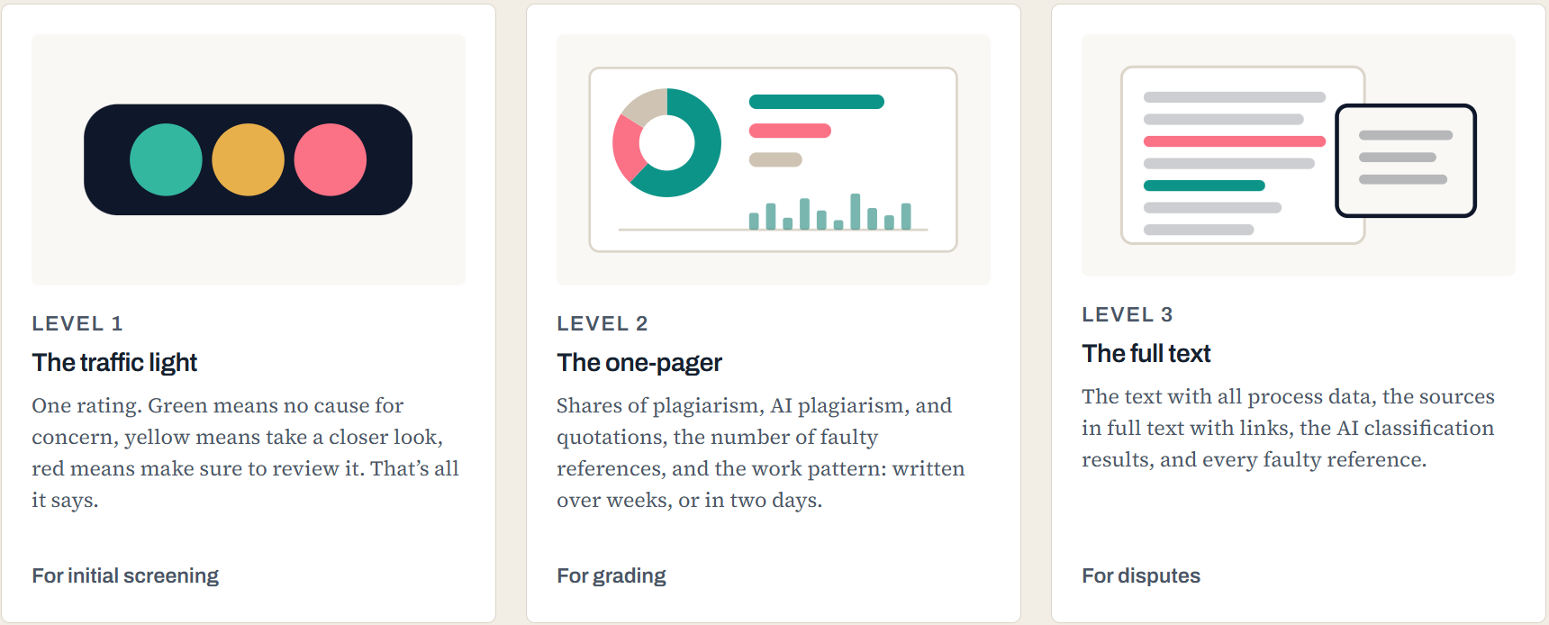
The solution at a glance
Different report levels for efficient review
13

Slide 14
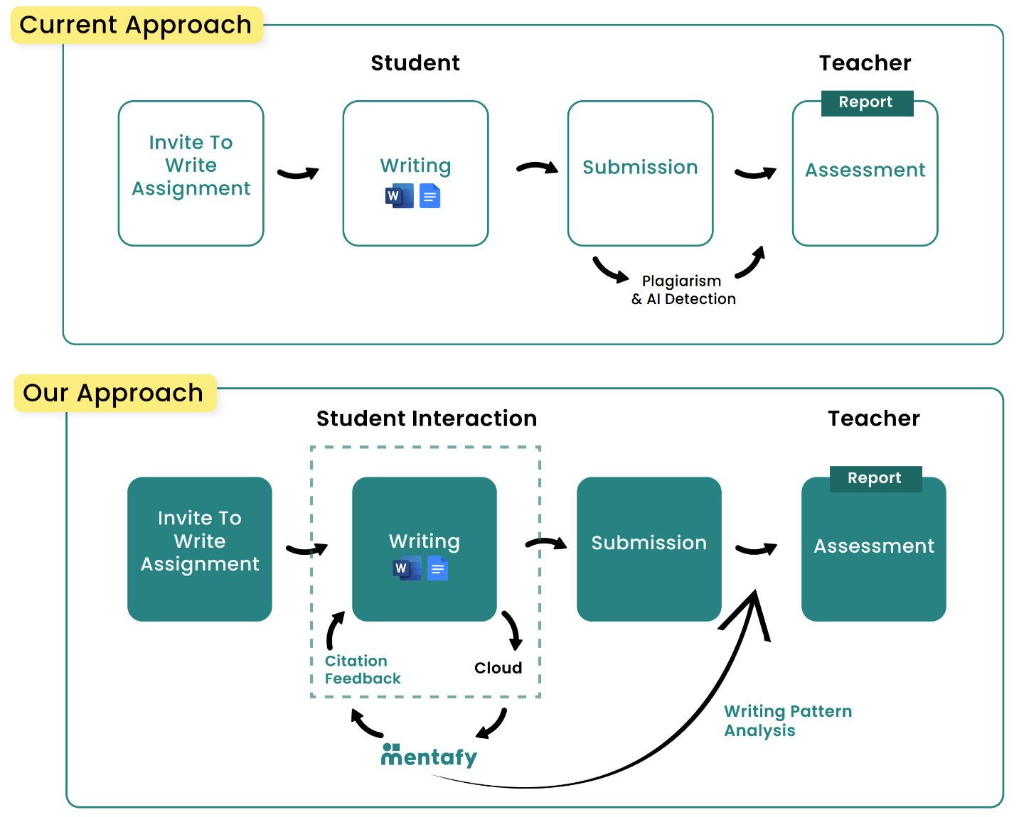
Assessment process
Only minimal changes to the workflow needed:
students write in their preferred word processor
Mentafy still offers this way of checking, i.e. plagiarism checking with AI detection on the finished document (e.g. PDF).
We recommend working with a version history in this process, or requiring it to be submitted, to substantially enrich the data available.
If we adapt the assessment process so we can take part in real time while the text is being written, we gain these benefits:
  Optional: students can get real-time feedback to correct mistakes as they write
  Transparency on source use, AI revision and fully generated text.
14

Slide 15
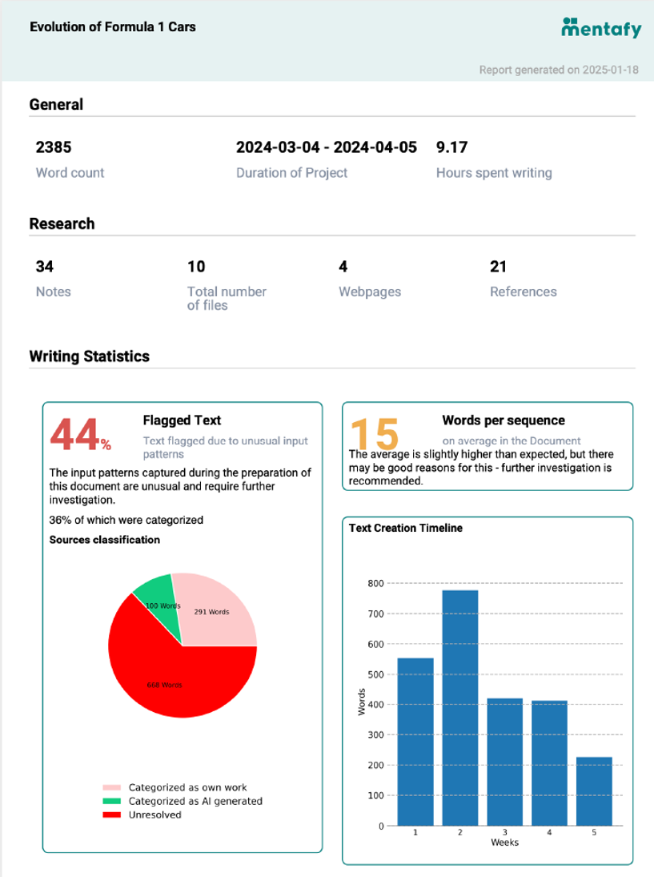
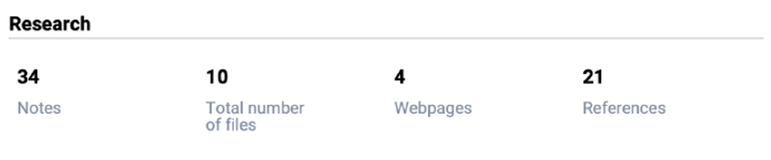
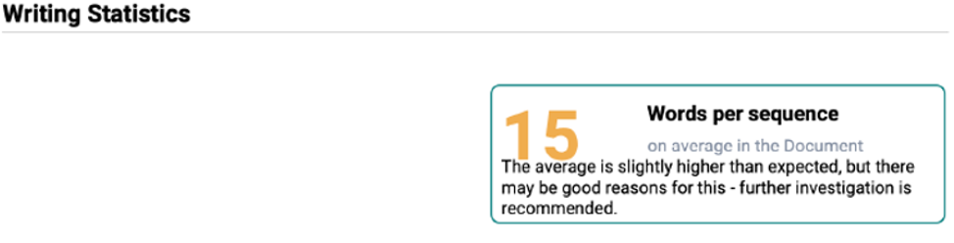
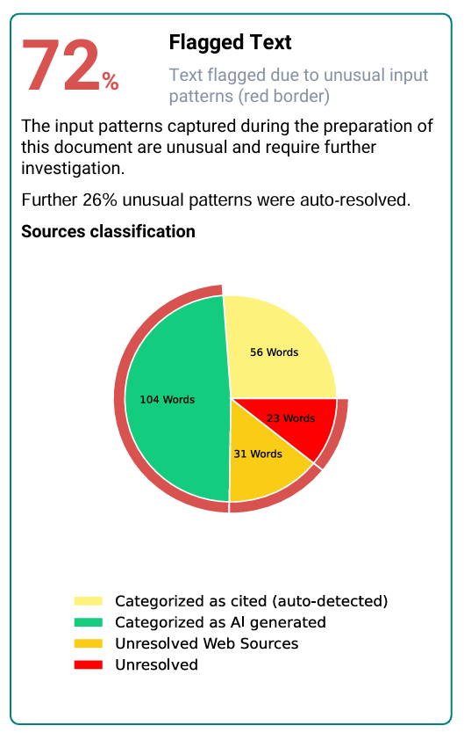
Authorship Report
Compact report formats for instructors and students
The report answers the following questions:
How much time was invested, and how is it distributed?
How much research was done, and is the bibliography authentic?
How much text was actually composed at the keyboard?
  Quotations vs. plagiarism vs. ghostwriting vs.
  AI-generated/AI-revised
→ Evidence that holds up before examination boards instead of vague “black-box” percentages
→ Results can always be shown and checked directly in the text
15
15

Slide 16
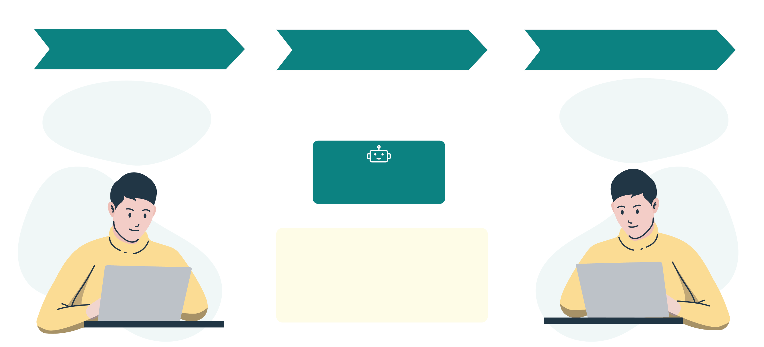
Writing mentor: an outlook
An intelligent tutoring system (ITS) that supports learning instead of policing it – beta MVP in Q1 2027
Draft
Mentor feedback
Result
“DNA has a double helix structure (see www.wikipedia.en/dna)”
“Watson and Crick (1953) were the first to describe the double helix of DNA.”
AI writing mentor (ITS)
Mentor tip
Wikipedia is often not a primary source:
Cite the original study on DNA structure.
Good primary sources: PubMed, …
16
Notes:
First draft -> mentor feedback -> second draft
AI writing mentor (ITS)
Reveal the stages one by one (animations)
Why we can do this and how we do it:
Data and editing expertise
We are analyzing an existing dataset of human tutoring sessions.
The teaching concept is being developed together with the writing research community
AI model
We start with a RAG approach and will then fine-tune an LLM foundation model (local instance / EU data center)
Reaching users
We are building this into an existing academic integrity solution, so students can use it right away and data to improve the tutor is collected continuously.
This gives instructors who use the Authorship Report to assess students’ own work a starting point.
A core element is creating moments of success and giving tips in the right places (in the right dose and at the right time).

Slide 17
Flexible implementation
Options for process documentation – you choose the depth
COMPLETE
DOCUMENTATION FREQUENCY
FINISHED DOCUMENT
Full cloud integration
Your choice
Retrospective analysis
Automated analysis of writing and research processes, integrated directly into Google Drive or OneDrive.
uploaded by students (all formats supported, as with Check)
  Weekly
  Daily
  Student chooses
via add-in
After submission: analyzing the version history gives retrospective insight into the writing process.
Note: if no version history is available, traditional analyses apply:
Plagiarism check
AI classification
Reference Verifier
For institutions that need a comprehensive analysis of writing and research integrity.
For maximum local data protection and minimal impact on IT infrastructure.
For all text formats; analysis of the finished document and versions, if available
17
Notes:
Relevant for IT: writing support needs no cloud, and the finished-document option needs no changes.

Slide 18
Competition
How does Mentafy compare with the competition?
Reliably assessing students’ own work
MENTAFY
TURNITIN
GRAMMARLY
GPTZERO
PANGRAM
PLAGAWARE
AI transparency
(low evidence)
(low evidence)
(low evidence)
(low evidence)
(low evidence)
Separating AI revision from AI generation
-
-
-
-
-
Evidence from version history
-
-
-
(announced for Q4 2025)
(in beta)
Servers in Germany
-
-
-
-
-
Research Recorder
-
-
-
-
-
18

Slide 19








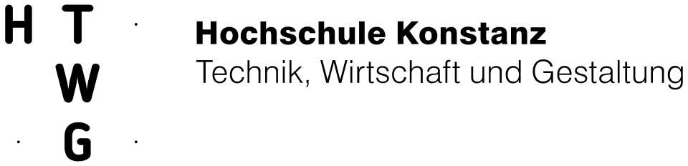
Pilot successfully completed in 2025
Teaching
Procurement
Administration
Superior, innovative technology (S³ + writing process)
Minimal effort (just write in Word, LibreOffice, etc.)
No false accusations of AI misuse
Full price transparency:
from €1 per student per year
No unpredictable module costs, and easy to purchase at department level too.
All-in-one: a complete academic integrity suite.
GDPR-compliant: designed for data minimization, servers in Germany
Assessment policy changes just like for plagiarism checks
Easy integration
(e.g. single sign-on, LMS)
19

Slide 20








Founding team
Experienced founders in academic integrity
We spotted the copy-and-paste plagiarism problem early, built PlagScan and helped build Ouriginal
Markus Goldbach
Johannes Knabe, PhD
Supplied plagiarism software to 2,000+ institutions worldwide.
Built the award-winning plagiarism software PlagScan and was CTO at Ouriginal.
LinkedIn
LinkedIn

Slide 21

Start a no-obligation pilot in your faculty or department
Markus Goldbach
CEO
Markus.Goldbach@mentafy.com
+49 175 5888661
Gottfried-Hagen-Str. 60-62
51105 Cologne, Germany
Book a webinar now
21

Slide 22
  QUESTIONS
  &
  ANSWERS

Slide 23
YOUR QUESTIONS –
OUR ANSWERS
Limited access
Complete solution: access to one dedicated folder in the cloud
Add-in: real-time access to exactly one document
Version history: access to exactly one document
Access is used solely to create the Authorship Report.
Folder management
Mentafy creates a separate folder for writing projects.
Read access: limited entirely to this folder
Uploaded materials are stored only in this folder.
Data protection and rights:
Mentafy keeps access to a minimum, as set out in the data processing agreement (DPA), and needs no further administrative rights.
Students’ privacy is fully protected.
What access rights does Mentafy receive at registration?

Slide 24
YOUR QUESTIONS –
OUR ANSWERS
Handwritten preparation
Mentafy is designed for digital processes. Notes and handwritten drafts are of course a proven method; we recommend uploading them alongside (a mobile app is available) or recording them in the Writing Journal.
Auto-save turned off
If auto-save is turned off, the detailed version history is missing. Instructors can make this clear: auto-save is the default and should stay on.
Add-in not activated
With this option, no documentation is created without the add-in.
→ Signals showing whether documentation is set up correctly can be viewed in the LMS or in Mentafy’s assignment management.
What happens if students make mistakes using Mentafy and the documentation is incomplete as a result?

Slide 25
YOUR QUESTIONS –
OUR ANSWERS
GDPR compliance
Full compliance with the General Data Protection Regulation (GDPR).
  We store only the data that is strictly necessary
  We are 100% transparent about what we store
  All data is always deleted as agreed
Our servers are hosted in Germany by Hetzner Online AG.
We sign a data processing agreement (DPA).
We regularly run comprehensive risk analyses to identify and minimize potential vulnerabilities.
How do you ensure compliance with data protection rules?

Slide 26
YOUR QUESTIONS –
OUR ANSWERS
Evidence instead of suspicion
Transparency tools secure traceable evidence (sources, history). They don’t assume anything; they document.
Fairness for honest students
Without checks, cheating pays off. Consistent procedures protect students’ own work and ensure fair grades.
Legal and procedural certainty
Verifiable criteria allow for a hearing, counter-evidence and appeal – more sound than gut feeling or black-box verdicts.
Legal strength doesn’t come from “the one score”, but from corroborated evidence (process data, text matches and AI indicators support each other) with a verifiable derivation. This turns suspicion into solid evidence – or, conversely, clears the student.
By using tools like Mentafy, am I not putting every student under suspicion?
Notes:
Why the combination holds up (better) in court
Triangulation instead of a single piece of evidence
Three independent sources of evidence (process data, text matches, AI indicators) support each other.
Consistency check (converging signals → strong evidence; diverging → restraint).
Reproducibility and traceability
Writing Process Analysis: timestamps, input sequences, revisions, source access (verifiable, exportable).
Plagiarism software: documented matches with locations (snippets, links, match percentage with context).
AI classification: as an indicator, with stated limitations, version/model status, score and thresholds.
Chain of custody
Unaltered original file + hash, collection logs, roles/rights, timestamps, system versions.
Audit trail: who saw or assessed what, and when; reports exported as attachments.
Methodological quality and proportionality
Detectors are never evidence on their own; they are the “indicator”, not the “verdict”.
Decisions rest on verifiable, explainable factors (process + plagiarism); the detector only supplements them.
Documented error rates/uncertainties; conservative thresholds; “in dubio pro discipulo” if the evidence doesn’t hold.
Practical, solid building blocks of evidence
Process report: start/pause/input rhythm, paste vs. typing patterns, source imports; atypical regularities.
Plagiarism report: specific matches (source, date, extent, context, paraphrase patterns).
AI indicators: consistent burstiness/perplexity profiles or similar, clearly labeled as indicators.
Correlation: e.g. large pasted blocks + simultaneous high plagiarism matches + AI indicator → high plausibility.
Procedural steps for legal defensibility
Policy and information (purpose, data, deadlines, right to appeal).
Standardized assessment template (criteria checklist + weighting).
Hearing and counter-evidence (student: working notes, drafts, source logs).
Second expert review (four-eyes principle) and documentation package (reports, exports, hashes).

Slide 27
YOUR QUESTIONS –
OUR ANSWERS
Transparent assessments
Turnitin and others rely on unreliable AI
pattern recognition.
Mentafy delivers verifiable, data-based evidence
through comprehensive Writing Process Analysis
Only our approach can tell
AI revision apart from AI-ghostwriting
Tamper-proof Writing Journal
Students create it in a standard format with Mentafy
Instructors get clear insight into students’ own work
(including their research).
Support instead of control
Focus on active support through source tips and project management.
The goal is to foster independence rather than primarily to detect misconduct.
No locked-down environment: students write in Word and similar programs.
Focus on data protection
No keyloggers or invasive methods.
Deleted text stays deleted with us (unlike,
for example, the version history that Google and Microsoft keep)
How is Mentafy different from the competition?

Slide 28
YOUR QUESTIONS –
OUR ANSWERS
Strong interest
Demand for a solution like Mentafy
is huge, and feedback confirms its relevance in education. 100+ organizations have checked 10,000+ documents.
Integration challenges
Educational institutions find it hard to switch to approaches that accompany the writing.
Institutions with Microsoft or Google licenses
can start right away.
For other providers, we develop custom solutions.
Easy-to-read reports
The Mentafy report is intuitive and takes minimal effort.
In-depth analysis is rarely needed, as the report usually provides enough information.
If needed, we help with detailed questions.
How have existing users received the product?

